Slide 1
ANOVA and Linear Regression Using R
DR LEONARD KITI ALII
PWANI UNIVERSITY

Slide 2
Comparison of means form several groups :The basic ANOVA situation
When the exposure variable has more than two categories, we often wish to compare the mean outcomes from each of the groups defined by these categories.
Example, - Wish to examine how the systolic blood pressure measurements collected as part of the routine hospital visits vary with age groups (3 categories) or sex or ethnic groups or socioeconomic classes.
Main Question: Do the means of the quantitative variables depend on which group the individual is in?
If categorical variable has only 2 values:
2-sample t-test
ANOVA allows for 3 or more groups

Slide 3
Informal Investigation
Graphical investigation:
side-by-side box plots
multiple histograms
Whether the differences between the groups are significant depends on
the difference in the means
the standard deviations of each group
the sample sizes
ANOVA determines P-value from the F statistic

Slide 4
What does ANOVA do?
At its simplest (there are extensions) ANOVA tests the following hypotheses:
H₀: The means of all the groups are equal.
H_{a}: Not all the means are equal
doesn’t say how or which ones differ.
Can follow up with “multiple comparisons”
Note: we usually refer to the sub-populations as “groups” when doing ANOVA.

Slide 5
Assumptions of ANOVA
Each group is approximately normal
check this by looking at histograms and/or normal quantile plots, or use assumptions
can handle some nonnormality, but not severe outliers
Standard deviations of each group are approximately equal

Slide 6
Description of the data
A sample of individual diagnosed with a particular disease and categorized as either
1 –” low diseased” 2 – “middle level diseased” and 3 – “highly diseased” . 4 drugs known to Control the systolic blood pressure were administered to the sampled individuals and their Systolic blood pressure recorded after 24 hours.
Question of interest --
Compare the means of systolic blood pressure by the drug administered, is there a significant difference in the drugs administered – One way ANOVA
Compare the means of the systolic blood pressure by the drug administered given the disease status of the individuals. – Two way ANOVA
DATA – systolic.csv

Slide 7
Summary of the data
Drug | n | Mean | Median | std | min | max
1 | 15 | 26.07 | 25 | 11.677 | -3 | 44
2 | 15 | 25.53 | 28 | 11.618 | 3 | 42
3 | 12 | 8.75 | 8 | 10.019 | -6 | 29
4 | 16 | 13.5 | 13.5 | 9.324 | -5 | 27

Slide 8
How ANOVA works (outline)
ANOVA measures two sources of variation in the data and compares their relative sizes
variation BETWEEN groups
for each data value look at the difference between its group mean and the overall mean
variation WITHIN groups
for each data value we look at the difference between that value and the mean of its group

Slide 9
The ANOVA F-statistic is a ratio of the Between Group Variaton divided by the Within Group Variation:
A large F is evidence against H₀, since it indicates that there is more difference between groups than within groups.

Slide 10
ANOVA Output
Analysis of Variance for days
Source DF SS MS F P
Drug 3 3133 1044.4 9.086 <0.000
Error 54 6207 114.9
Total 57 9340
SS stands for sum of squares
ANOVA splits this into 3 parts

Slide 11
So How big is F?
Since F is
Mean Square Between / Mean Square Within
= MSG / MSE
A large value of F indicates relatively more
difference between groups than within groups (evidence against H₀)
To get the P-value, we compare to F(k-1,n-1)-distribution
k-1 degrees of freedom in numerator (# groups -1)
n – k degrees of freedom in denominator

Slide 12
PRACTICAL
Memory drug Placebo No Treatment
70 37 3
77 43 10
83 50 17
90 57 23
97 63 30
Drug=rep(c("memory drug", "placebo", "No treatment"),5)
Scores=c(70,37,3,77,43,10,83,50,17,90,57,23,97,63,30)
Colnames=c("Drug","Scores")A =data.frame(Drug,Scores)
plot(A)
B=aov (A$Scores~A$Drug)
summary(B)
plot(B)

Slide 13
BARTLETT and SHAPIRO TESTS
bartlett.test(A$Scores,A$Drug)
test of homogeneity of variances
shapiro.test(resid(B))
Normality test

Slide 14
Linear Regression
Assumptions
Variables are normally distributed
Variables are related linearly
Errors are identically and independently (normally) distributed with mean zero and equal variance
Covariance between predictors and error terms is zero
No correlation between the predictors

Slide 15
Models
One dependent and one independent variables-simple linear regression
E.g BMI with weight
One DV and two or more IV-multiple linear regression
BMI with weight and height
Two or more DV with two or more IV- Multivariate linear regression

Slide 16
Concept of linear regression
Mean of Y is a straight line function of X, plus an error term or residual
Goal is to find the best fit line that minimizes the sum of the error terms

Slide 17
R code
# Loading the data “cars” from the data set in R
plot(cars$speed~cars$dist, pch=16)
plot(cars$speed~cars$dist, pch=16,main = "SST")
abline(mean(cars$speed),0) #grandmean
for(i in 1:130) lines(c(cars$dist[i],cars$dist[i]),c(mean(cars$speed),cars$speed[i]),lty=2)

Slide 18
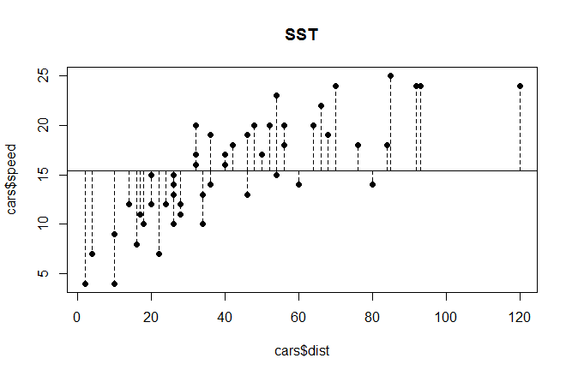
Plot for SST

Slide 19
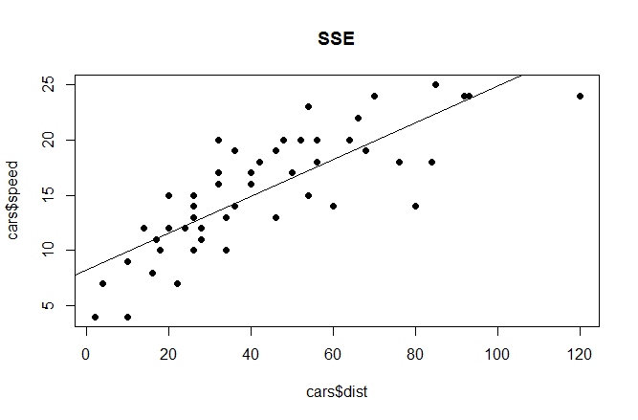
SSE

Slide 20
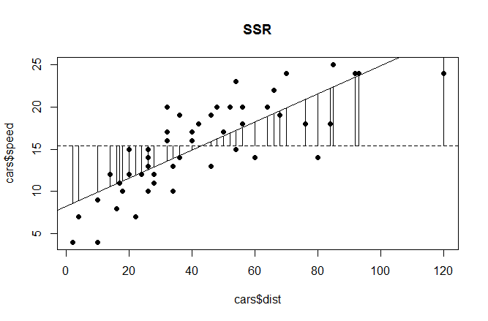
plot(cars$speed~cars$dist,pch=16,main="SSR") abline(mean(cars$speed),0,lty =2) model<-lm(cars$speed~cars$dist) abline(model) for(i in 1:130) lines(c(cars$dist[i],cars$dist[i]),c(mean(cars$speed),predict(model)[i]))

Slide 21
model<-lm(cars$speed~cars$dist) summary(model)
Call:
lm(formula = cars$speed ~ cars$dist)
Residuals:
Min 1Q Median 3Q Max
-7.5293 -2.1550 0.3615 2.4377 6.4179
Coefficients:
Estimate Std. Error t value Pr(>|t|)
(Intercept) 8.28391 0.87438 9.474 1.44e-12 ***
cars$dist 0.16557 0.01749 9.464 1.49e-12 ***
---
Signif. codes: 0 ‘***’ 0.001 ‘**’ 0.01 ‘*’ 0.05 ‘.’ 0.1 ‘ ’ 1
Residual standard error: 3.156 on 48 degrees of freedom
Multiple R-squared: 0.6511, Adjusted R-squared: 0.6438
F-statistic: 89.57 on 1 and 48 DF, p-value: 1.49e-12

Slide 22
Interpretation
Speed =8.2 dist + 0.17
R squared – explains how line best fits
Adjusted R Squared – adjusts for predictor variables
Residual s.e = square root of error variance
F = MSReg/MSE
P-value – for checking significance of the F statistic.

Slide 23
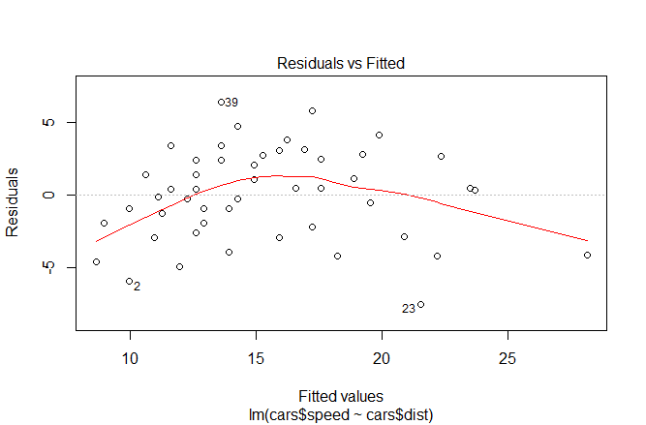
DIAGNOSTICS – Residual plot

Slide 24
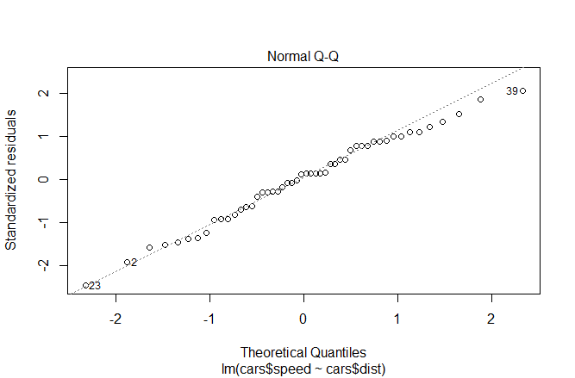
Normal QQ plot

